Slide 1

Data Science 107
Python & Watson Cloud Services

Slide 2
Schedule
 | Title | Description | Exercise
1 | Python 101 | Intro to syntax and core concepts | Python workbook
2 | Data Analysis | Analysis libraries (numpy and pandas) | CO2 Analysis
3 | Databases | DB storage and SQL | Build own database
4 | Visualisation | Sexy graphs, charts, and wordclouds | Colourful visualisation
5 | Machine Learning | Simple models | Regression & Decision Trees
6 | Machine Learning | Complex models - Neural Networks | Visual recognition
7 | Watson Integration | Integrating with Watson cloud services | Watson labs

Slide 3
Outline
Approach & Documentation
Follow-on Learning
Examples Walkthrough

Slide 4
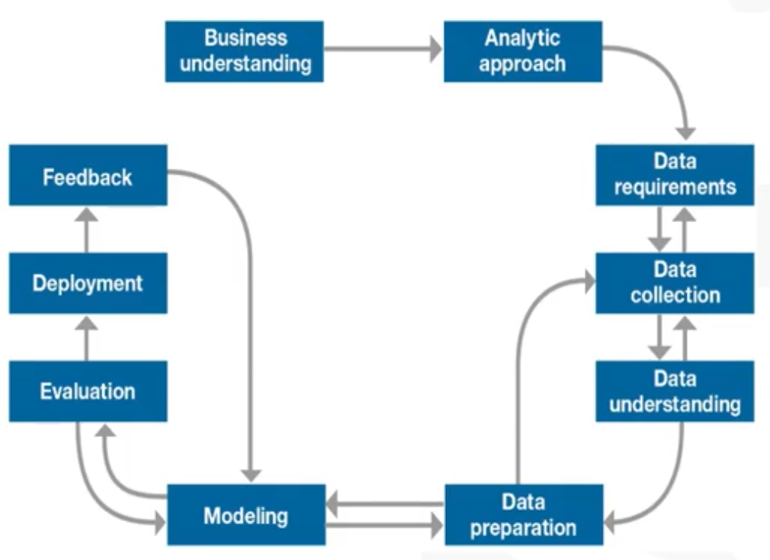
The latter stages of our DS Journey

Slide 5
ibm-watson Package
https://pypi.org/project/ibm-watson/
Well-maintained library that helps us connect to Watson APIs using Python
Handles lots of overhead:
Authentication
Security
Logging

Slide 6

Watson APIs
The documentation for connecting to Watson services is available from https://cloud.ibm.com/apidocs/
You can search for specific products
If you’re lucky, you’ll get code examples in your chosen language e.g.
Visual Recognition (python)
Text to Speech (python)

Slide 7
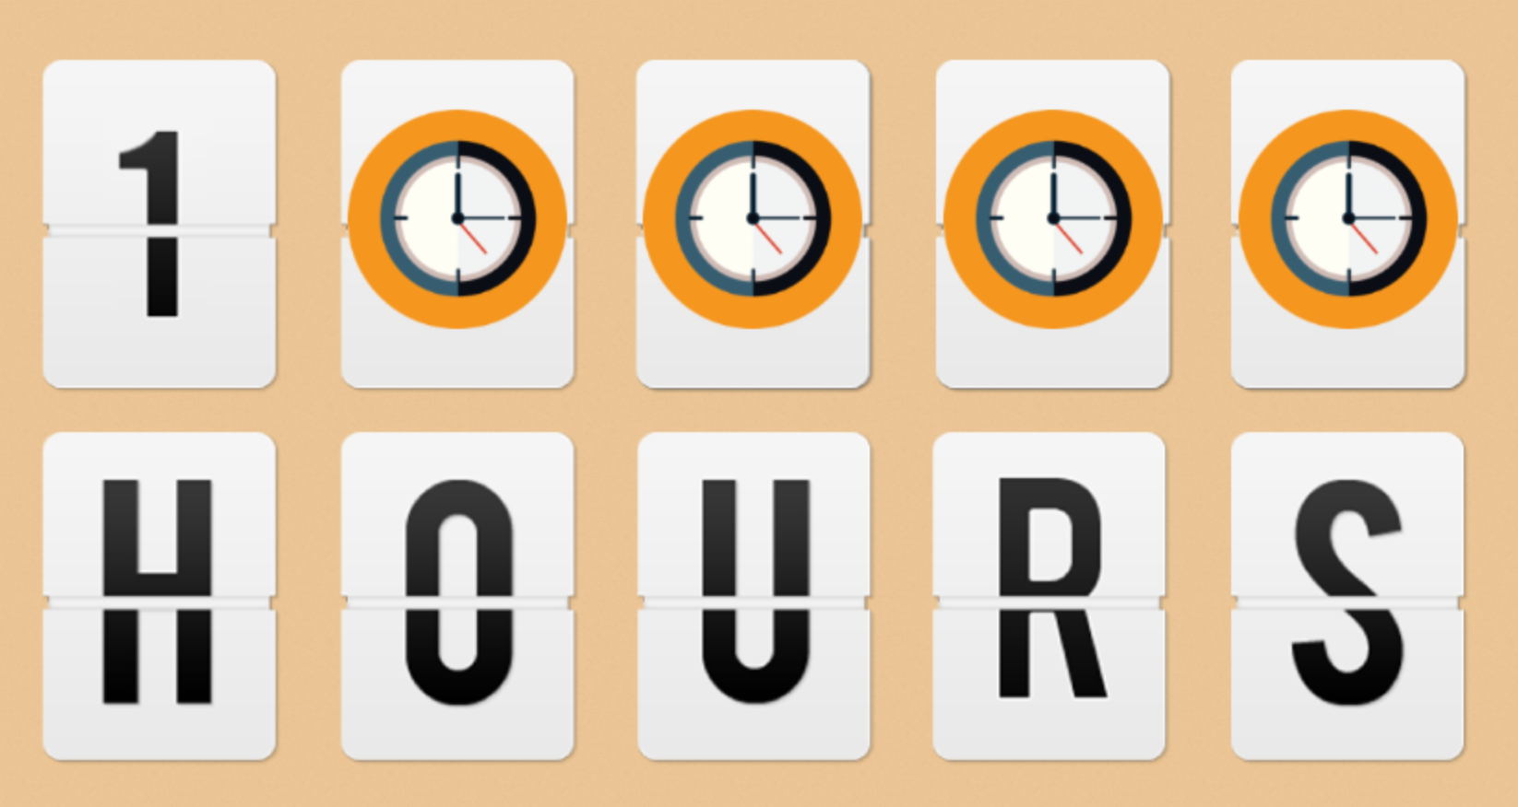
(Optional) Follow-On Learning
Embed skills by practicing on your own
Follow the step-by-step IBM-Watson featured projects
Medical language NLC
Chatbot moderator that pulls angry texts and explicit images
Come up with your own ideas and see if you can design and build it
Ask me and the community to collaborate

Slide 8
Let’s get doing

